Slide 1

Testing and Verification (CSC7056/CSC3056)
Aidan McGowan
Specification (Black Box) based testing techniques

Slide 2
Specification-based testing technique
Also known as ‘black-box’ or input/output driven testing techniques because they view the software as a black-box with inputs and outputs.
The testers have no knowledge of how the system or component is structured inside the box.
In black-box testing the tester is concentrating on what the software does, not how it does it.
Both functional and non-functional testing
Appropriate at all levels of testing (component testing through to acceptance testing)

Slide 3
Specification Based or Black-Box Techniques
  There are several specification-based or black-box techniques:
  Equivalence Partitioning
  Boundary Value Analysis
  Decision Table Testing
  State Transition Testing
  Use Case Testing
Used to design dynamic tests

Slide 4
Equivalence Partitioning (EP)
It can be applied at any level of testing and is often a good technique to use first.
The idea behind this technique is to divide (i.e. to partition) a set of test conditions into groups or sets that can be considered the same (i.e. the system should handle them equivalently), hence ‘equivalence partitioning’. Equivalence partitions are also known as equivalence classes – the two terms mean exactly the same thing.

Slide 5
Equivalence Partitioning (EP)
In equivalence-partitioning technique we need to test only one condition from each partition. (This is because we are assuming that all the conditions in one partition will be treated in the same way by the software.)
If one condition in a partition works, we assume all of the conditions in that partition will work, and so there is little point in testing any of these others.
Similarly, if one of the conditions in a partition does not work, then we assume that none of the conditions in that partition will work so again there is little point in testing any more in that partition.

Slide 6
EP - Degree classification example
Valid data domain
Valid partitions
0
40
50
60
70
100
Fail
Third
2.2
2.1
First
Invalid partitions

Slide 7
EP - Degree classification example
Principle :
Only one test value needed from each partition to prove the rule
Example equivalence partitioning test values
-7 19 46 53 65 74 104
0
40
50
60
70
100
Fail
Third
2.2
2.1
First

Slide 8
EP Exercise
System for Life Insurance
Rules :
  0-17 Too young “No - minor”
  18-65 Acceptable “Yes”
  66-99 Too old “No - Retired”
How would this be coded …?

Slide 9
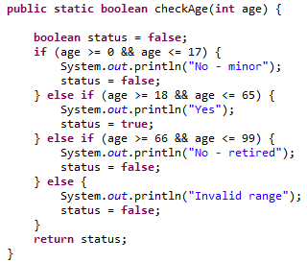
EP Exercise
Coded …
Now how would it be tested using EP to design and develop test cases?

Slide 10
EP Exercise
-2 6 40 73 110
0
18
65
99
No - minor
Yes
No - retired

Slide 11
Selecting a value in the range
Referring to the code …
It doesn’t need to check every
individual value in the range
either.
Question is which value to test for in the range ..
Rule of thumb … test the middle one.

Slide 12
Equivalence Partitioning (EP)
Partitions may be valid or invalid.
EP is a technique used to achieve input and output coverage.
It can be applied to human input, input via interfaces to system or interface parameters in integration testing.

Slide 13
More EP exercises….
A savings account in a bank has a different rate of interest depending on the balance in the account.
  3% rate of interest is given if the balance in the account is in the range of £0 to £100
  5% rate of interest is given if the balance in the account is in the range of £100 to £1000
  7% rate of interest is given if the balance in the account is £1000 and above
Notes:
In the above example we have identified four partitions, even though the specification mentioned only three. This shows a very important task of the tester that is a tester should not only test what is in the specification, but should also think about things that haven’t been specified. In this case we have thought of the situation where the balance is less than zero. We haven’t (yet) identified an invalid partition on the right, but this would also be a good thing to consider. In order to identify where the 7% partition ends, we would need to know what the maximum balance is for this account (which may not be easy to find out). In our example we have left this open for the time being. Note that non-numeric input is also an invalid partition (e.g. the letter ‘a’) but we discuss only the numeric partitions for now. We have made an assumption here about what the smallest difference is between two values. We have assumed two decimal places, i.e. $100.00, but we could have assumed zero decimal places (i.e. $100) or more than two decimal places (e.g. $100.0000) In any case it is a good idea to state your assumptions – then other people can see them and let you know if they are correct or not. When designing the test cases for this software we would ensure that all the three valid equivalence partitions are covered once, and we would also test the invalid partition at least once. So for example, we might choose to calculate the interest on balances of-$10.00, $50.00, $260.00 and $1348.00. If we hadn’t specifically identified these partitions, it is possible that at least one of them could have been missed at the expense of testing another one several times over. Note that we could also apply equivalence partitioning to outputs as well. In this case we have three interest rates: 3%, 5% and 7%, plus the error message for the invalid partition (or partitions). In this example, the output partitions line up exactly with the input partitions. How would someone test this without thinking about the partitions? A inexperienced tester (let’s call him Robbin) might have thought that a good set of tests would be to test every $50. That would give the following tests: $50.00, $100.00, $150.00, $200.00, $250.00, … say up to $800.00 (then Robbin would have got tired of it and thought that enough tests had been carried out). But look at what Robbin has tested: only two out of four partitions! So if the system does not correctly handle a negative balance or a balance of $1000 or more, he would not have found these defects – so the naive approach is less effective than equivalence partitioning. At the same time, Robbin has four times more tests (16 tests versus our four tests using equivalence partitions), so he is also much less efficient. This is why we say that using techniques such as this makes testing both more effective and more efficient. Note that when we say a partition is ‘invalid’, it doesn’t mean that it represents a value that cannot be entered by a user or a value that the user isn’t supposed to enter. It just means that it is not one of the expected inputs for this particular field.

Slide 14
More EP examples…
Insurance for Drivers
  0-18 : none
  19-25 : £2000
  26-35 : £1750
  36-65 : £1500
  66-75 : £2000
  75+ : £3500
Notes:
-1, 9, 22, 30, 50, 70, 80

Slide 15
Boundary Value Analysis (BVA)
Based on testing at the boundaries between partitions.
Here we have both valid boundaries (in the valid partitions) and invalid boundaries (in the invalid partitions).
Proves that the points at which the code changes have been encoded properly
For each boundary marker the 3 boundary values should be tested

Slide 16
Specification Based or Black-Box Techniques
Boundary Value Analysis
Degree classification example
Invalid boundary values
Valid boundary values
0
40
50
60
70
100
-1 1 39 41 49 51 59 61 69 71 99 101
Fail
Third
2.2
2.1
First
Boundary markers

Slide 17
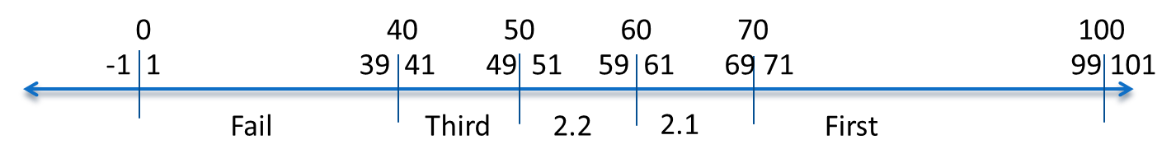
Boundary Value Analysis (BVA) – the process
Select the boundary values (For each boundary marker the 3 boundary values should be tested
Then select one value in the valid and one value in the invalid portion.
In this example 18 tests required

Slide 18
Specification Based or Black-Box Techniques
Boundary Value Analysis
Characteristics:-
  Proves that the points at which the code changes have been encoded properly
  For each boundary marker the 3 boundary values should be tested

Slide 19
Specification Based or Black-Box Techniques
Boundary Value Analysis
Location of Boundary Values
  Greater than or equal to 70 First
  Greater than or equal to 60 but less than 70 2.1
  Greater than or equal to 50 but less than 60 2.2
  Greater than or equal to 40 but less than 50 Third
  Less than 40 Fail

Slide 20
BVA - How many boundary values?
Using three values - 18 tests required
Alternative (2 boundary values) - 12 tests required
-1 0 39 40 49 50 59 60 69 70 100 101
Fail
Third
2.2
2.1
First

Slide 21
BVA – Insurance Example
Rules :
  0-17 Too young “No - minor”
  18-65 Acceptable “Yes”
  66-99 Too old “No - Retired”
What are the Boundary values for this ?
  (Use three boundary policy)
Notes:
3 stage : -1, 0, 1, 17, 18, 19, 65, 66, 67, 98,99, 100 (12 tests)

Slide 22
BVA – Insurance Example
Rules :
  0-17 Too young “No - minor”
  18-65 Acceptable “Yes”
  66-99 Too old “No - Retired”
What are the Boundary values for this ?
  (Use two boundary policy)
Notes:
2 stage : -1, 0, 17, 18, 65, 66, 99, 100 (8 tests)

Slide 23
EP and BVA Exercise
Revise the Degree Tests – to include 3 Step BVA and EP.
What are the test cases – how many ?
Notes:
-1, 0, 1, (20), 39, 40, 41, (45), 49, 50, 51, (55), 59, 60, 61, (65), 69, 70, 71, (80), 99,100,101
23 total or 25 if separate invalid EQ portions of -10 and 110 however are these really necessary ?

Slide 24
Why both EP and BVA ?
Technically, because every boundary is in some partition, if you did only boundary value analysis you would also have tested every equivalence partition. However, this approach may cause problems if that value fails – was it only the boundary value that failed or did the whole partition fail?
Also by testing only boundaries we would probably not give the users much confidence as we are using extreme values rather than normal values.

Slide 25

Why both EP and BVA ?
Consider a printer “number of pages to print” example…
Suppose we test only the valid boundary values 1 and 99 and nothing in between. If both tests pass, this seems to indicate that all the values in between should also work. However, suppose that one page prints correctly, but 99 pages do not. Now we don’t know whether any set of more than one page works !

Slide 26
Decision Table Testing & State Transition Testing
The techniques of equivalence partitioning and boundary value analysis are often applied to specific situations or inputs.
However, if different combinations of inputs result in different actions being taken, this can be more difficult to show using equivalence partitioning and boundary value analysis, which tend to be more focused on the user interface.
Enter : decision tables and state transition testing. (Which are more focused on business logic or business rules.)

Slide 27
Decision Table Testing
A decision table is a good way to deal with combinations of things (e.g. inputs). This technique is sometimes also referred to as a ’cause-effect’ table.
Decision tables provide a systematic way of stating complex business rules, which is useful for developers as well as for testers.
Decision tables can be used in test design whether or not they are used in specifications, as they help testers explore the effects of combinations of different inputs and other software states that must correctly implement business rules.

Slide 28
Decision Table Testing
It helps the developers to do a better job can also lead to better relationships with Testers. Testing combinations can be a challenge, as the number of combinations can often be huge. Testing all combinations may be impractical if not impossible. We have to be satisfied with testing just a small subset of combinations but making the choice of which combinations to test and which to leave out is also important. If you do not have a systematic way of selecting combinations, an arbitrary subset will be used and this may well result in an ineffective test effort.

Slide 29
How it works ?
Input conditions are identified.
Actions are the processes that should be executed by the system depending on the combinations of input combinations.
We identify a unique combination of conditions – (rules) – that result in the execution of one or more actions.

Slide 30
A Decision Table …
 | Rule 1 | Rule 2 | … | Rule x
Conditions
Condition 1
Condition 2
…
Condition y
Actions
Action 1
Action 2
…
Action z

Slide 31
Using the technique
Car insurance – a company specialising in Vintage Car Insurance will insurance anyone with a car older than 30 years in age (inclusive) and if the driver aged is 50 or over.
2 Conditions - owner over 50 & owns car older than 30 years
We calculate the number of rules based 2^{n} where n is the number of conditions.
One possible action – offer insurance.

Slide 32
Using the technique
 | Rule 1 | Rule 2 | Rule 3 | Rule 4
Conditions
Driver >=50 | Y | Y | N | N
Car >=30 | Y | N | Y | N
Actions
Offer Insurance | Y | N | N | N

Slide 33
Login Screen
Login Screen
  User enters a value for both Username and password then the entry is processed.
  User enters username only – Error message (“Enter password”)
  User enters password only – Error message (“Enter username”)
  User enters nothing – Error message (“Enter username and password”)

Slide 34
Login Screen - Using the technique
 | Rule 1 | Rule 2 | Rule 3 | Rule 4
Conditions
Username entered | Y | Y | N | N
Password entered | Y | N | Y | N
Actions
Process login attempt | Y
Username error message |  |  | Y
Password error message |  | Y
Username and password error message |  |  |  | Y

Slide 35
Decision table exercise
Vintage car update –
  Applicants are able to enter their details on web page, the system does a series of checks to determine whether or not to offer cover and decide on level of discount.
  The applicant must have a vintage car (car in excess of 29 years)
  If applicant has 5 years no claims bonus, give them 50% discount.
  If they are a member of a owners club give them 10% discount.

Slide 36
Decision table exercise
 | Rule 1 | Rule 2 | Rule 3 | Rule 4 | Rule 5 | Rule 6 | Rule 7 | Rule 8
Conditions
Actions

Slide 37
Decision table exercise
 | Rule 1 | Rule 2 | Rule 3 | Rule 4 | Rule 5 | Rule 6 | Rule 7 | Rule 8
Conditions
Car >= 30 | Y | Y | Y | Y | N | N | N | N
No claims 5 years | Y | Y | N | N | Y | Y | N | N
Member club | Y | N | Y | N | Y | N | Y | N
Actions
Offer insurance | Y | Y | Y | Y | N | N | N | N
50% off | Y | Y | N | N | - | - | - | -
10% off | Y | N | y | N | - | - | - | -

Slide 38
Applying the rules ..
Applicant A : owns a Nissan Bluebird 1981 and is a member of the Nissan owners club.
Applicant B : owns a Datsun Stanza 1978. Did make an insurance claim last year.
Applicant C : owns a Ferrari Dino 1960. Member of the Ferrari owners club. Crashed the car two years ago.
Use the decision table to decide if each should be offered insurance and if so how much discount (if any)…

Slide 39
Outcomes …
Applicant A : owns a Nissan Bluebird 1981 and is a member of the Nissan owners club. -
Offer insurance + 10%
Applicant B : owns a Datsun Stanza 1978. Did make an insurance claim last year.
Offer insurance
Applicant C : owns a Ferrari Dino 1960. Member of the Ferrari owners club. Crashed the car two years ago.
Offer insurance + 10% (although did the driver make a claim ?)

Slide 40
State Transition testing
State transition testing is used where some aspect of the system exhibits a different response depending on current conditions or previous history (state).
This simply means that the system can be in a number of different states.
The transitions from one state to another are determined by the rules of the system.
Testing includes valid and invalid state transitions.

Slide 41
State Transition testing
The state system is often shown as a state diagram.
Two subtle differences can be modelled ..
  Entities
    An item exists for only a short period of time. The diagram has a start and end point.
    For example order entry.
  Finite state machines
    No beginning and no end
    For example an ATM which is always on

Slide 42
How it works
Need firstly to identify…
  The various states of the system
  The Transitions from one state to another
  The triggers that cause the state change
  The Actions that result from the change.

Slide 43
How is works - states
Each state is represented by a circle containing the name / description of the state.
Watch TV

Slide 44
How is works - transitions
The movement from one state to another – line with an arrow indicating the direction of the change.
Each transition will have an event - the trigger that cause the transition
Each transition will have an Action – a system activity that occurs as part of the transition. (optional)
Event
Event /Action

Slide 45
How is works - states
It Is possible to have a transition that goes nowhere – returns to the original state
Watch TV

Slide 46
How is works – Diagrams with Entities
Will have a start and end point
Start
End

Slide 47
Example
Booking a driving lesson online.
  A client can reserve a driving lesson by request. At this point it is only Provisional.
  Provisional reservations can be held for 2 days.
  The booking is only confirmed when a payment is made by the client.

Slide 48
Example
Request lesson / Timer Started
Payment received / Timer stopped
Provisional
Booked

Slide 49
Example
If the payment is not received within two days. The timer expires and the system automatically cancels the booking
Request lesson / Timer Started
Payment received / Timer stopped
Provisional
Booked
Timer expired / cancel record
Booking cancelled

Slide 50
State Diagram exercise…. Online ordering
Ordering an item online.
The online Basket is initially empty.
Ordering an item adds the item to the basket
The item can be removed from the basket
Once payment is requested and authorised the item is removed from the basket and logged in the DB.

Slide 51
State Diagram exercise…. Online ordering
Confirm Order Payment OK / item ordered (logged in DB)
Item selected / add to basket
Login to system
Basket Empty
Basket with item
Remove / Item removed from basket
Confirm Order Payment Refused

Slide 52
State diagram for PIN entry
Start
Eat card
Card inserted
PIN Not OK
PIN Not OK
PIN Not OK
Wait for PIN
2nd try
3rd
try
PIN OK
PIN OK
PIN OK
Access to account
Notes:
Source : Foundations of Software Testing. Black et al

Slide 53
State Transition Table
The state transition diagrams are good at identifying valid transitions.
To help with invalid cases a State Transition Table is useful.

Slide 54
State Transition Table
Events
States
 | Insert Card | Valid PIN | Invalid PIN
S1 – Start | S2 | - | -
S2 – Wait for PIN | - | S5 | S3
S3 – 2nd Try Invalid | - | S5 | S4
S4 - 3rd Try Invalid | - | S5 | S6
S5 – Access account | - | ? | ?
S6 – Eat card | S1 (for new card) | - | -

Slide 55
In deriving test cases
First test case here would be the normal situation, where the correct PIN is entered the first time.
A second test (to visit every state) would be to enter an incorrect PIN each time, so that the system eats the card.
A third test we can do is where the PIN was incorrect the first time but OK the second time and another test where the PIN was correct on the third try.

Slide 56
Decision table - Exercise
Create a state decision table for Booking a driving lesson online
 | Request booking | Timed out | Payment made
S1 –
S2 –
S3 –
S4 -

Slide 57
Decision table – Exercise (solution)
 | Request booking | Timed out | Payment made
S1 – Start | S2 | - | -
S2 – Provisional booking | - | S4 | S3
S3 – Booked | - | ? | ?
S4 - Cancelled | - | ? | ?

Slide 58
Switch coverage
We need to be able to identify the coverage of a set of tests in terms of transitions. We can also consider transition pairs and triples and so on. Coverage of all individual transitions is also known as 0-switch coverage, coverage of transition pairs is l-switch coverage, coverage of transition triples is 2-switch coverage, etc.
1-Switch coverage is consider the most efficient.
Deriving test cases from the state transition model is a black-box approach. Measuring how much we have tested (covered) we will discuss in a white-box perspective. However, state transition testing is regarded as a black-box technique.

Slide 59
Use case transactions
Use case testing is a technique that helps us identify test cases that exercise the whole system on a transaction by transaction basis from start to finish.
A use case is a description of a particular use of the system by an actor (a user of the system). Each use case describes the interactions the actor has with the system in order to achieve a specific task.
Use cases are a sequence of steps that describe the interactions between the actor and the system.

Slide 60
Use case transactions
Use cases are defined in terms of the actor, not the system, describing what the actor does and what the actor sees rather than what inputs the system expects and what the system’s outputs.
They often use the language and terms of the business rather than technical terms, especially when the actor is a business user.
They serve as the foundation for developing test cases mostly at the system and acceptance testing levels.
Use cases can uncover integration defects, that is, defects caused by the incorrect interaction between different components.

Slide 61
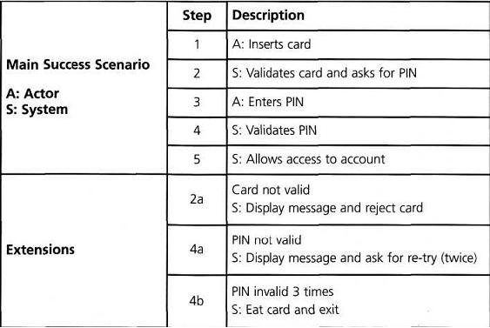
Use case transactions – example ATM
Notes:
Source : Foundations of Software Testing. Black et al

Slide 62
Exam questions

Slide 63
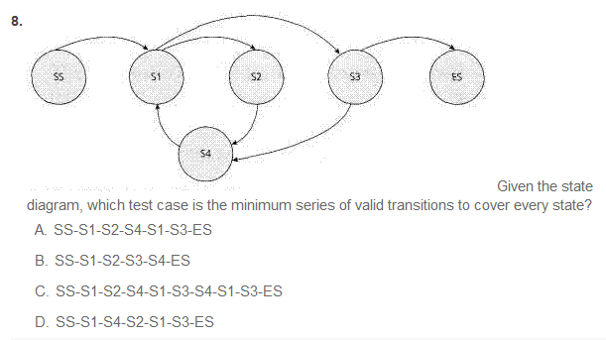
Notes:
A (to cover each state)
C ( to cover each transition)

Slide 64
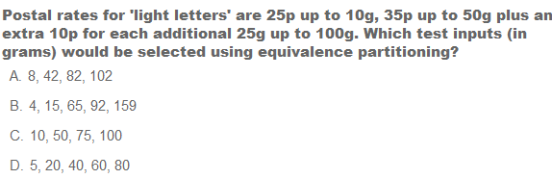
Notes:
B or C (includes invalid region)?

Slide 65
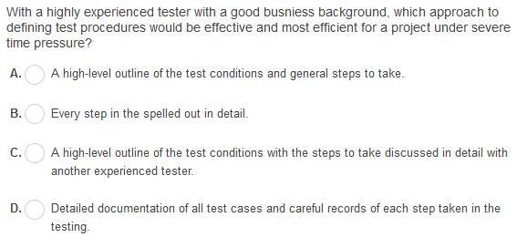
Notes:
A

Slide 66
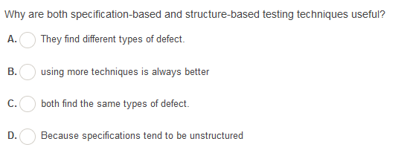
Notes:
A

Slide 67
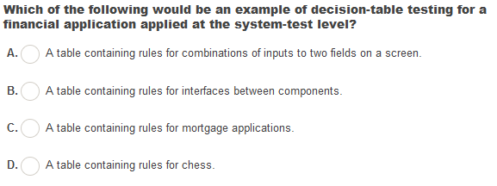
Notes:
C

Slide 68
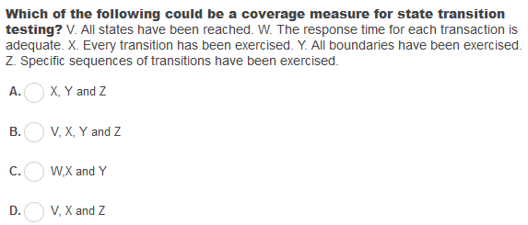
Notes:
D

Slide 69
Given the following decision table
Rule 1 Rule 2 Rule 3 Rule 4
Conditions
UK resident? False True True True
Age between 18 - 55? Don’t care False True True
Smoker? Don’t care Don’t care False True
Actions
Insure client? False False True True
Offer 10% discount? False False True False
What is the expected result for each of the following test cases?
A.TC1: Fred is a 32 year old smoker resident in London
B.TC3: Jean-Michel is a 65 year non-smoker resident in Paris
1 A – Insure, 10% discount, B – Insure, no discount.
2 A – Don’t insure, B – Don’t insure.
3 A – Insure, no discount, B – Don’t insure.
4 A – Insure, no discount, B – Insure with 10% discount.
Notes:
3

